Slide 1

Drama At Cornwallis Academy
Year 7 – LESSON 3
Lesson Objective:
To investigate the use of Thought Tracking.
To understand how to use Thought Tracking within a scene.

Slide 2
Level | Drama Strand
 | Creating | Performing | Reflecting
Entry | I can take part in a drama activity | I can participate in part of a group performance | I can identify positive and negative aspects within my work
1 | I can take part in a range of drama activities I can explore problems in an imagined world and make up plays from stories or other stimuli | I can participate in a short group performance I show some consideration of movement and voice in performance | I can make simple connections between the dramas I experience and my own life I can recognise when my own work and the work of others’, could be improved
2 | I can perform my own simple scenes, demonstrating an understanding of drama techniques | I can use my voice and body to create a simple character I can act out improvised dramas | I can talk about why I made certain decisions in my play I can show a basic understanding of how meaning can be shown
3 | I can establish a character with control over movement and voice I can use the dialogue in existing texts as well as creating my own I can devise plays from a range of stimuli I can respond to the use of drama techniques to deepen the role or understanding of the situation e.g. hot seating I can sustain a defined character for a reasonable amount of time | I can learn lines and organise simple performances | I can give suggestions on how work could be improved I can talk about my work using some technical drama terminology I can discuss and give reasons for my preferences in the drama I have seen

Slide 3
WHAT IS THOUGHT TRACKING?
Lesson Objective:
To investigate the use of Thought Tracking.
To understand how to use Thought Tracking within a scene.
I wonder if I will ever be a professional painter?
It's when within a still image or a scene a character will say something about how they are feeling or what they are thinking. Thought-tracking helps the audience understand how the character is feeling and what their point of view of the situation is.

Slide 4


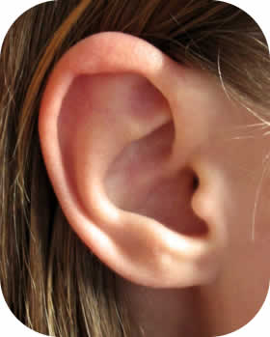

4 WAYS OF THOUGHT TRACKING
Lesson Objective:
To investigate the use of Thought Tracking.
To understand how to use Thought Tracking within a scene.
What my MIND thinks
What my EYES see
What my EARS here
What my heart feels

Slide 5

TRAFFIC LIGHTS
Lesson Objective:
To investigate the use of Thought Tracking.
To understand how to use Thought Tracking within a scene.
Students walk around the space.
Red = Stop, Green = Go, Amber = Slow Motion.
During the game the teacher may asks students to imagine different scenarios or asks students to perform a Still Image of a situation when Red is called.
The teacher may ask the students to add a thought track to their images.

Slide 6
DIALOGUE
Lesson Objective:
To investigate the use of Thought Tracking.
To understand how to use Thought Tracking within a scene.
TEACHER: Where’s your homework?
STUDENT: I forgot it.
TEACHER: Right, well you can do it after school tomorrow in detention.
STUDENT: I can’t do tomorrow Sir.
TEACHER: You’ll do it whenever I say so.
STUDENT: Yes Sir
Notes:
Use this Dialogue to explain thought tracking. This slide shows the normal conversation.

Slide 7
DIALOGUE
Lesson Objective:
To investigate the use of Thought Tracking.
To understand how to use Thought Tracking within a scene.
TEACHER: Where’s your homework?
(I bet he hasn’t done it again)
STUDENT: I forgot it.
TEACHER: Right, well you can do it after school tomorrow in detention.
(I wish I didn’t have to do this, he’s a nice student)
STUDENT: I can’t do tomorrow Sir.
TEACHER: You’ll do it whenever I say so.
(Why does he have to push me to the limit)
STUDENT: Yes Sir
Notes:
This shows the thought tracking of the teacher.

Slide 8
DIALOGUE
Lesson Objective:
To investigate the use of Thought Tracking.
To understand how to use Thought Tracking within a scene.
TEACHER: Where’s your homework?
STUDENT: I forgot it.
(Why does he always pick on me?)
TEACHER: Right, well you can do it after school tomorrow in detention.
STUDENT: I can’t do tomorrow Sir.
(My mum’s going in to hospital tomorrow)
TEACHER: You’ll do it whenever I say so.
STUDENT: Yes Sir
(I would have done it if mum wasn’t so ill)
Notes:
This shows the thought tracking of the student.

Slide 9
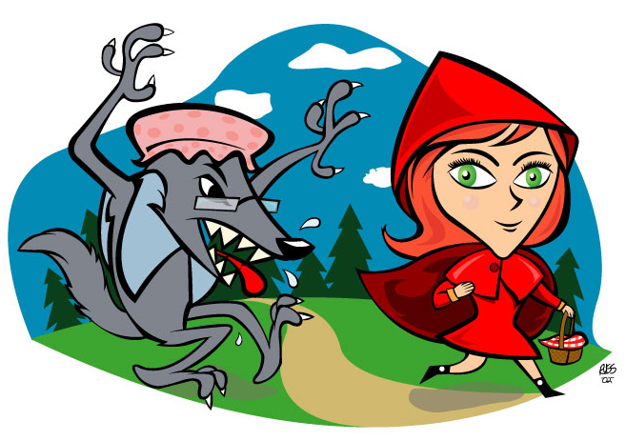
LITTLE RED RIDING HOOD
Lesson Objective:
To investigate the use of Thought Tracking.
To understand how to use Thought Tracking within a scene.
Re-cap the story of Little Red Riding Hood in your groups through Still Images.

Slide 10
MODEL
Lesson Objective:
To investigate the use of Thought Tracking.
To understand how to use Thought Tracking within a scene.
Teacher will model effective Thought Tracking

Slide 11
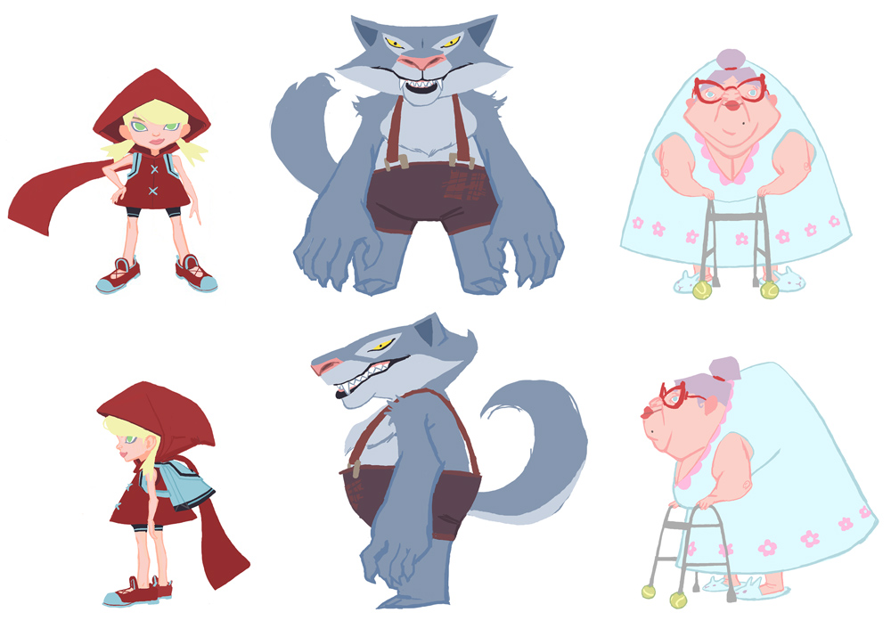
LITTLE RED RIDING HOOD – THROUGH THE EYES OF...
Lesson Objective:
To investigate the use of Thought Tracking.
To understand how to use Thought Tracking within a scene.
Each group will tell the story of Little Red Riding Hood through the eyes of a particular character.
Each group must use Thought Tracking to tell the story from their characters point of view by adding a thought track to each Still Image.
THE CHARACTERS
Little Red Riding Hood
The Wolf
The Grandmother

Slide 12
REMEMBER
Lesson Objective:
To investigate the use of Thought Tracking.
To understand how to use Thought Tracking within a scene.
Step out to say Thought Track
A thought is different to normal speech
A thought is not always what we expect…it is often something different

Slide 13
STOP AND SHOW
Lesson Objective:
To investigate the use of Thought Tracking.
To understand how to use Thought Tracking within a scene.
Teacher will stop you at a random moment and check progress…
Teacher may spotlight a group…
So stay on a task!

Slide 14
SPOTLIGHTING
Lesson Objective:
To investigate the use of Thought Tracking.
To understand how to use Thought Tracking within a scene.
Spotlight all groups and observe their work.
WWW – What Went Well?
What worked and why?
What could be improved? And why?

Slide 15
Lesson Objective:
To investigate the use of Thought Tracking.
To understand how to use Thought Tracking within a scene.
Summing up:
What have you learnt today?
What level have you achieve and how/ why?
What do you need to do to meet your target grade?
Get into a pair.
Share your knowledge and ideas with your partner

